Slide 1
Data Insights and Presentation
Task-3(KPMG Virtual Internship)
Vishnav Tuli
13/07/23

Slide 2
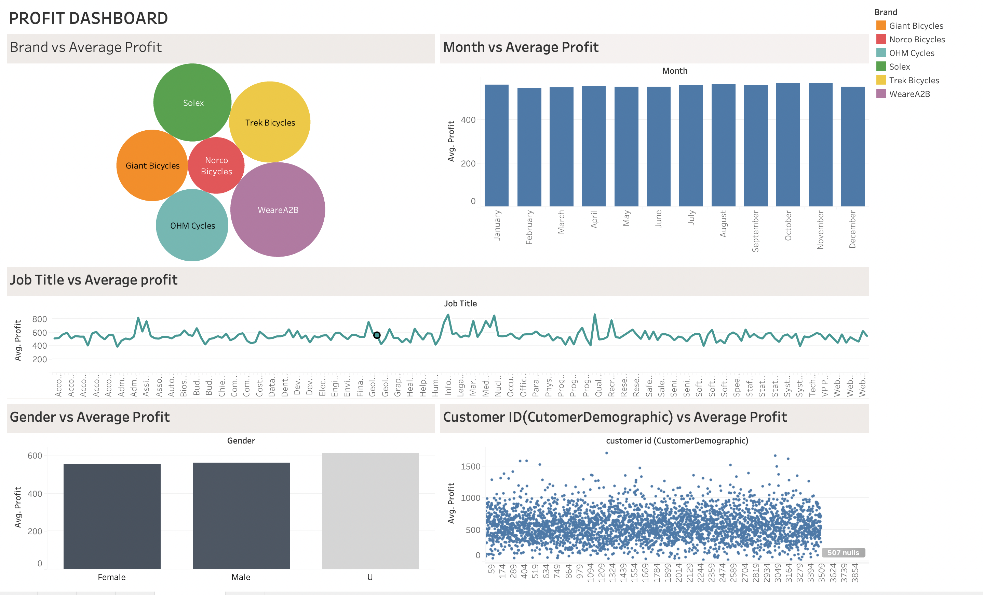

Final Dashboard
Vishnav Tuli

Slide 3
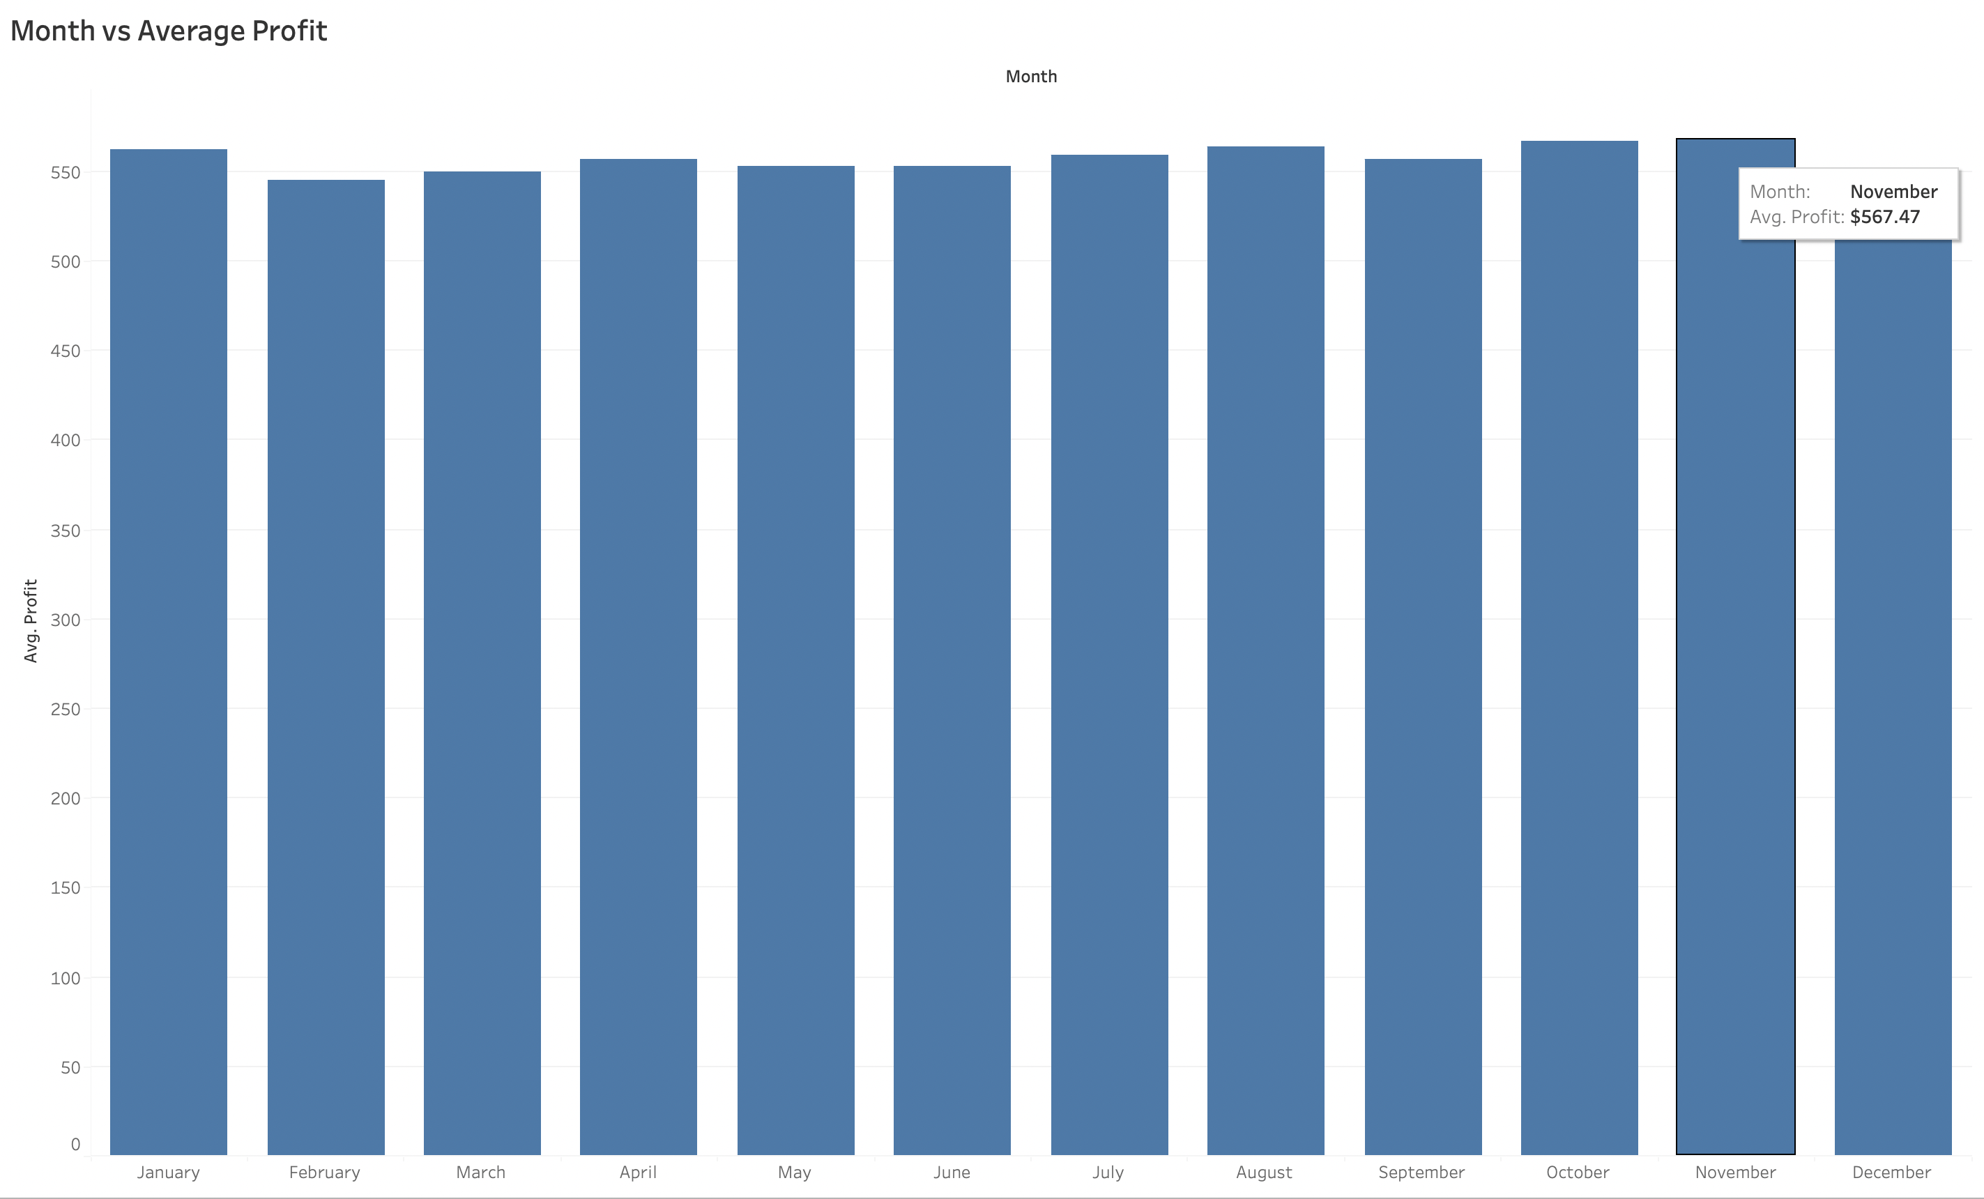
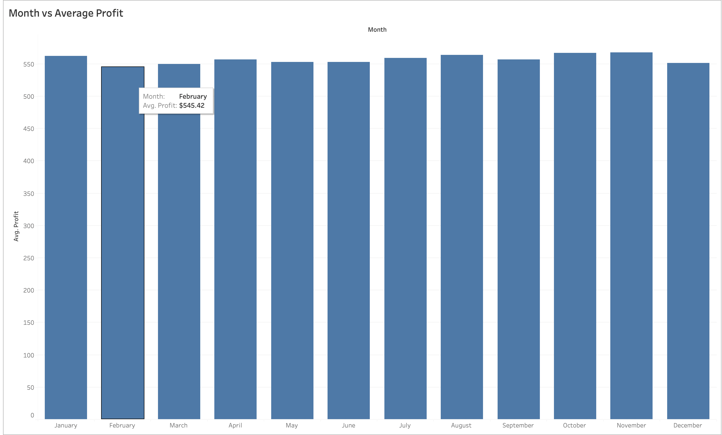
Vishnav Tuli
Vishnav Tuli
During our data analysis, we examined the relationship between transaction month and average profit. The results indicated that November had the highest average profit among all the months, amounting to $567.47. On the other hand, February had the lowest profit of $545.42. This analysis enables us to identify the crucial months for profit enhancement.
To facilitate a clear understanding of the data patterns, I created bar graph to represent this trend. The graph visually displays the variations in average profit across different transaction months. By observing the graph, we can easily identify the months that are critical for boosting profitability. This graphical representation provides a concise and comprehensive overview of the relationship between transaction months and average profit, enabling easier interpretation and analysis of the data.

Slide 4
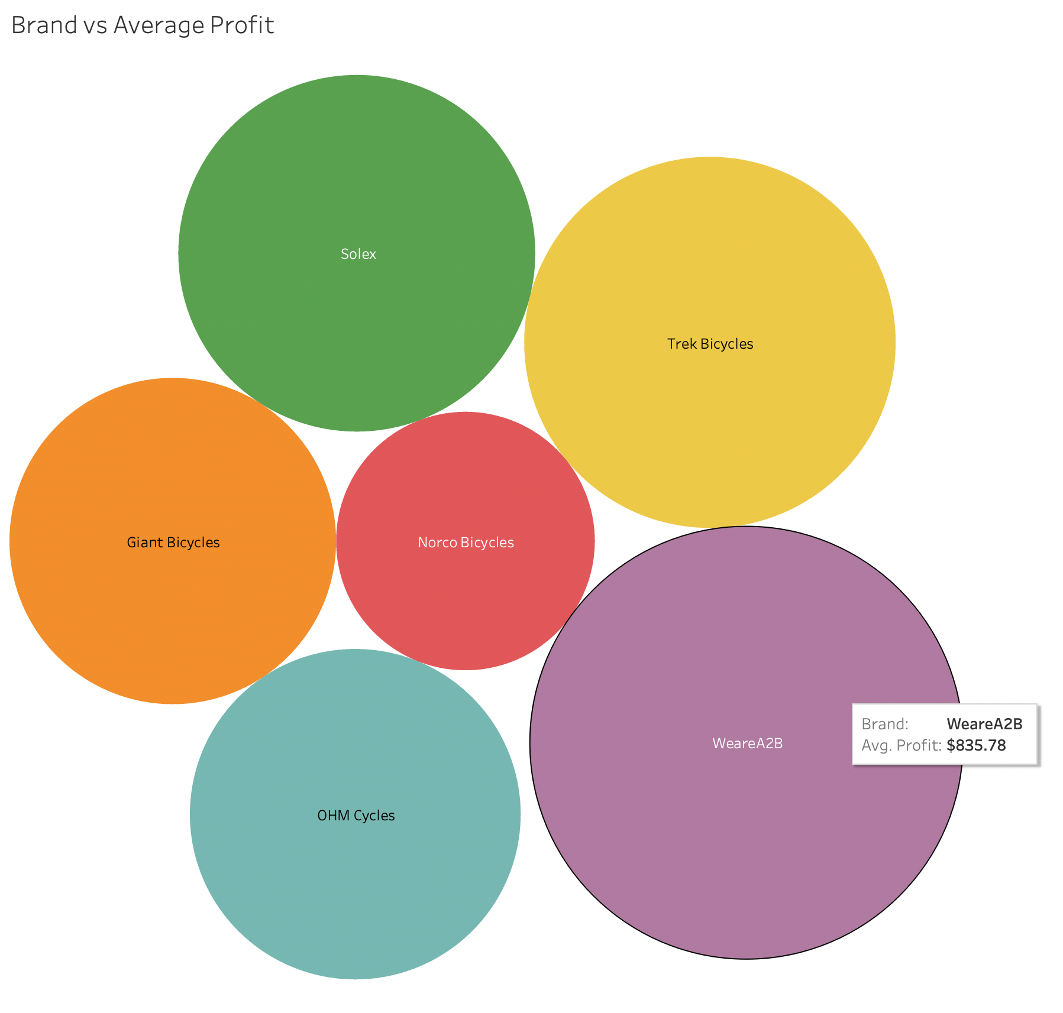
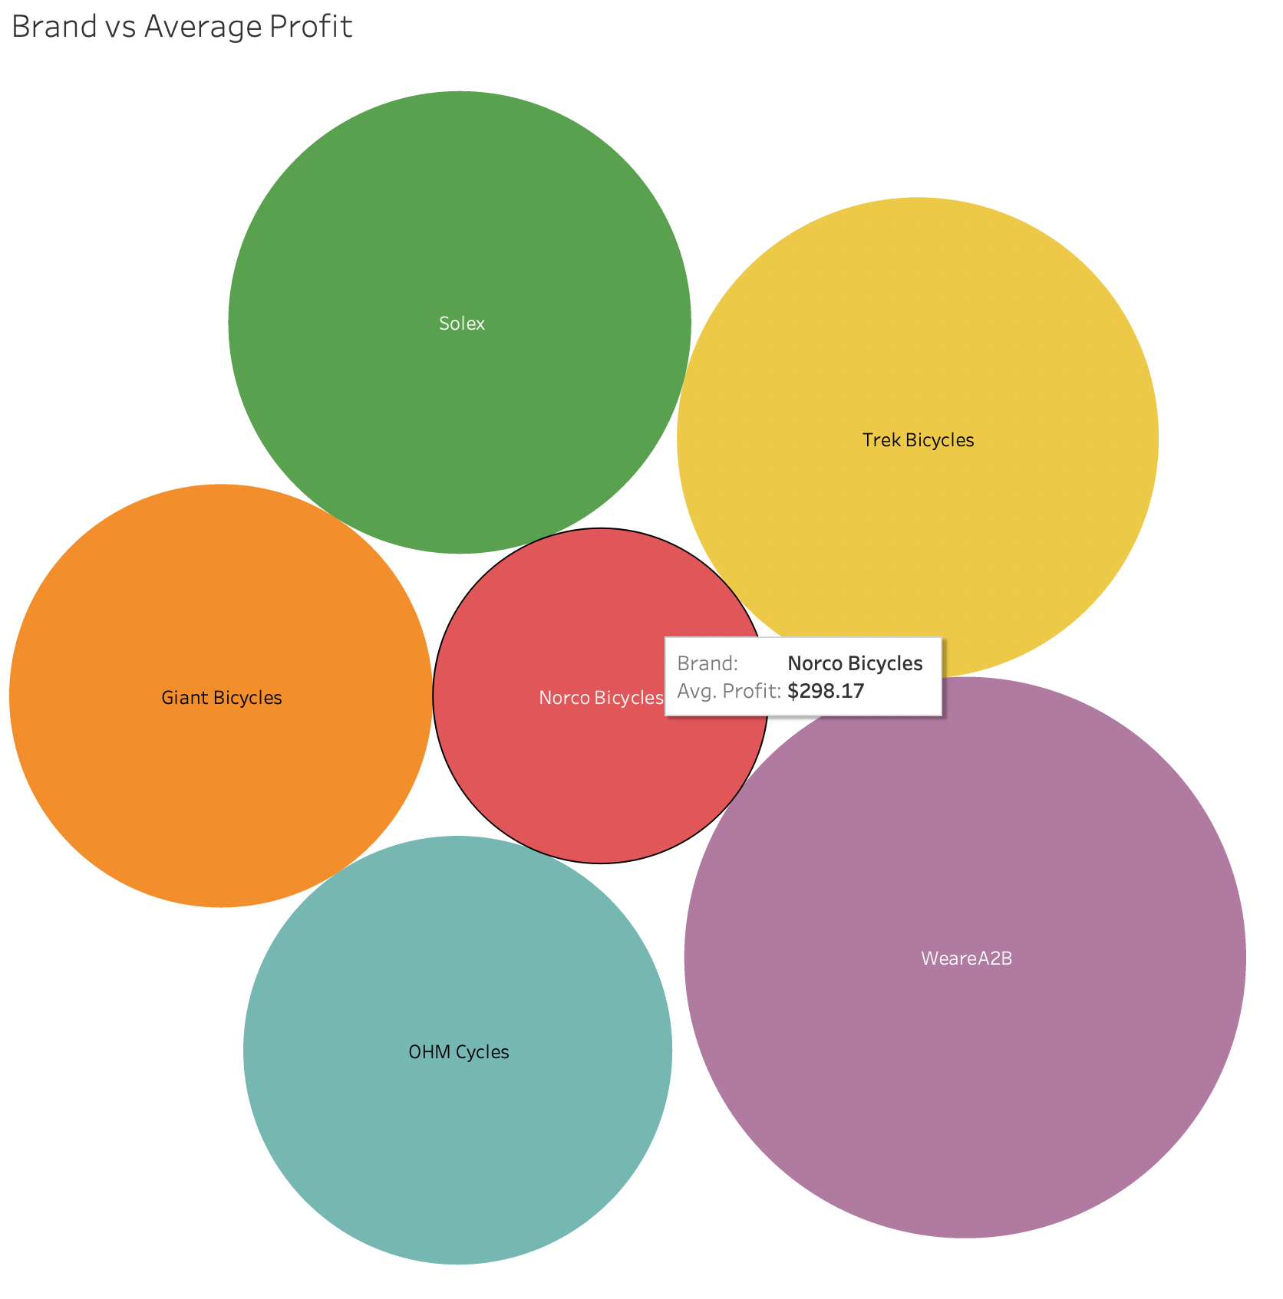
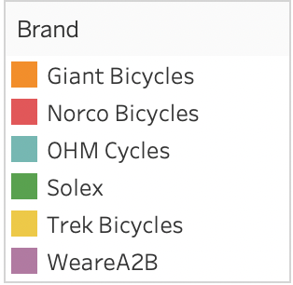
Vishnav Tuli
Vishnav Tuli
In our data analysis, we looked at the relationship between different brands and their average profits. We found that the brand "WeareA2B" had the highest average profit of $835.78, while "Norco Bicycles" had the lowest profit of $298.17. To make it easier to understand, I created a pie chart that shows the distribution of profits among different brands. This chart helps us see which brand is generating the most revenue at a glance.

Slide 5
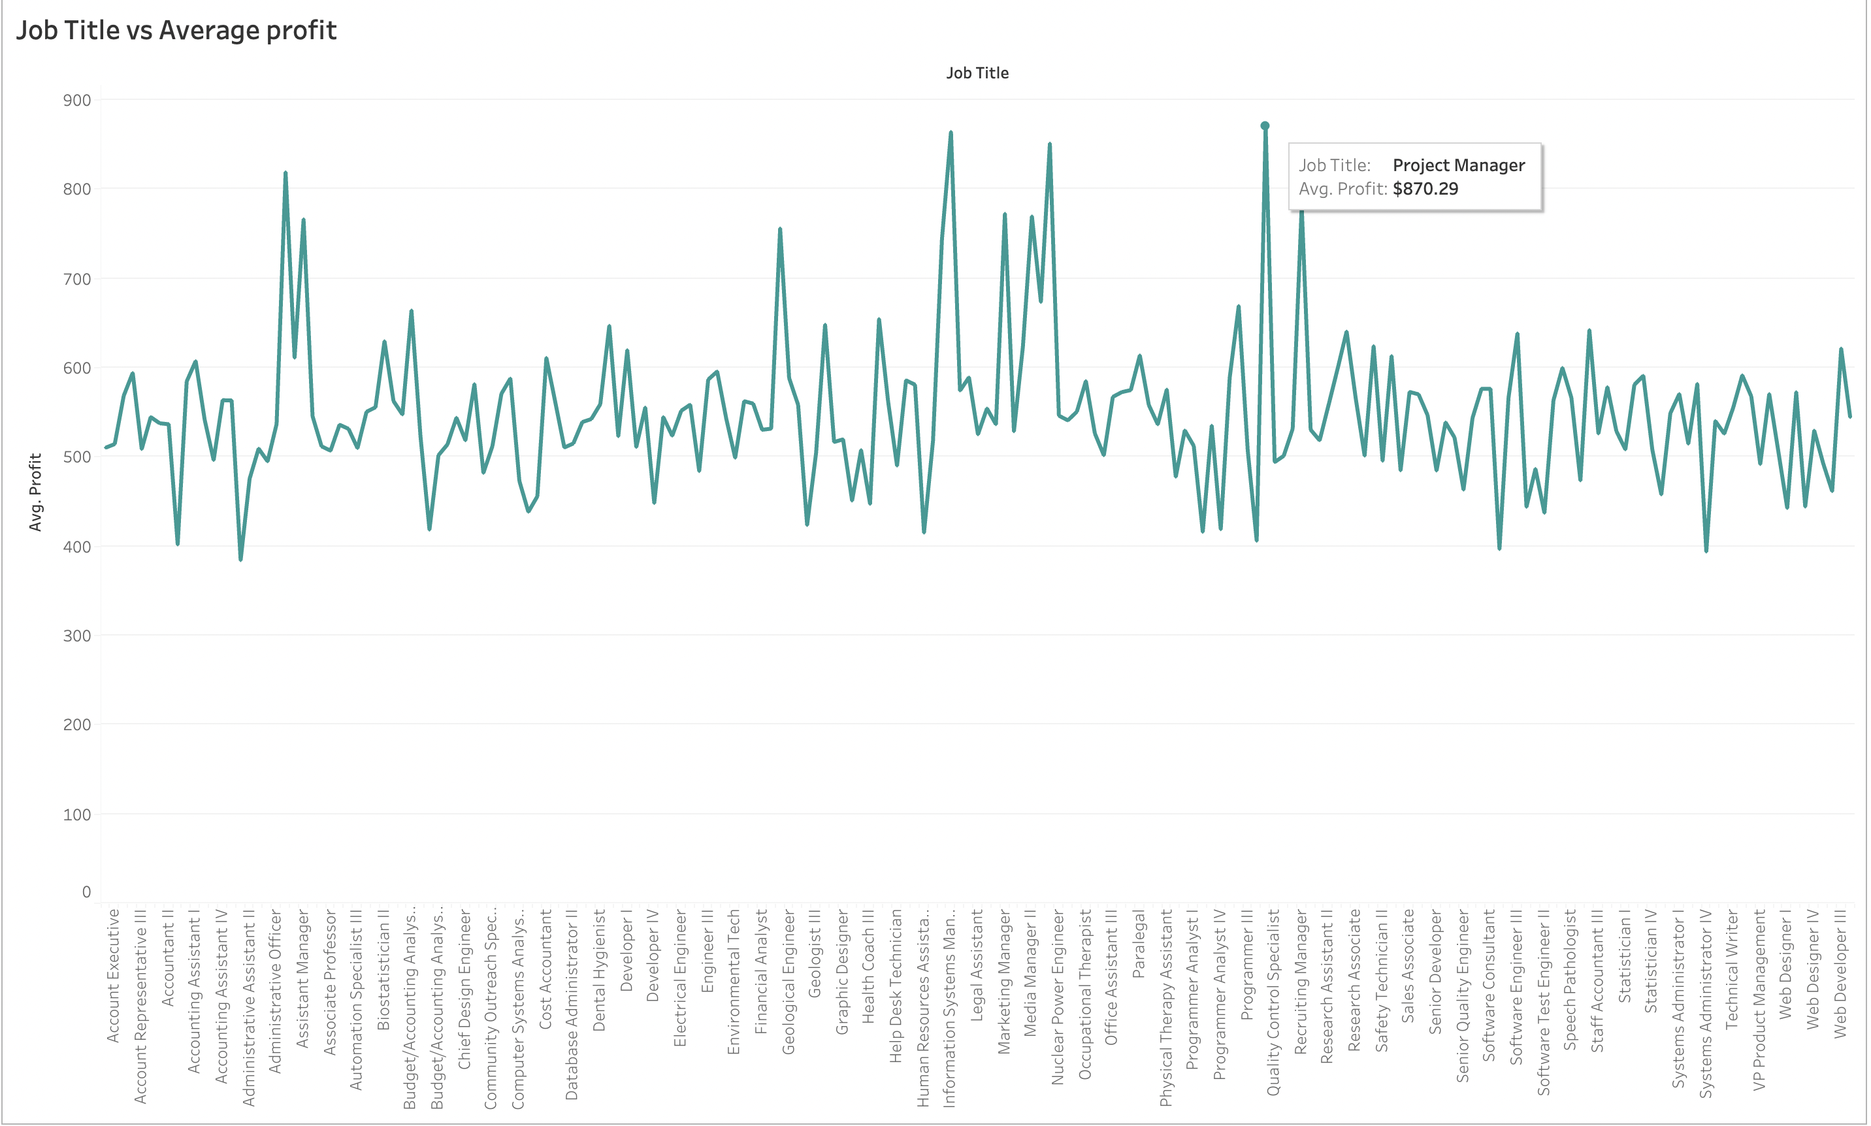
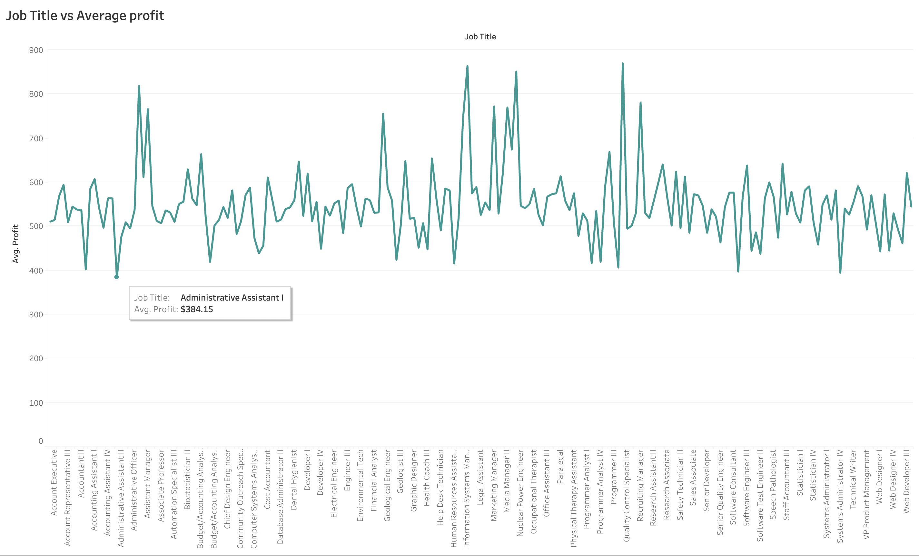
Vishnav Tuli
Vishnav Tuli
In our data analysis, we found that the job title of Project Manager had the highest average profit of $870.28, while the lowest profit was $384. To present these findings clearly, I created a line graph that illustrates the trends and variations in average profit across different job titles. This graph allows for easy visualization and understanding of the data patterns.

Slide 6
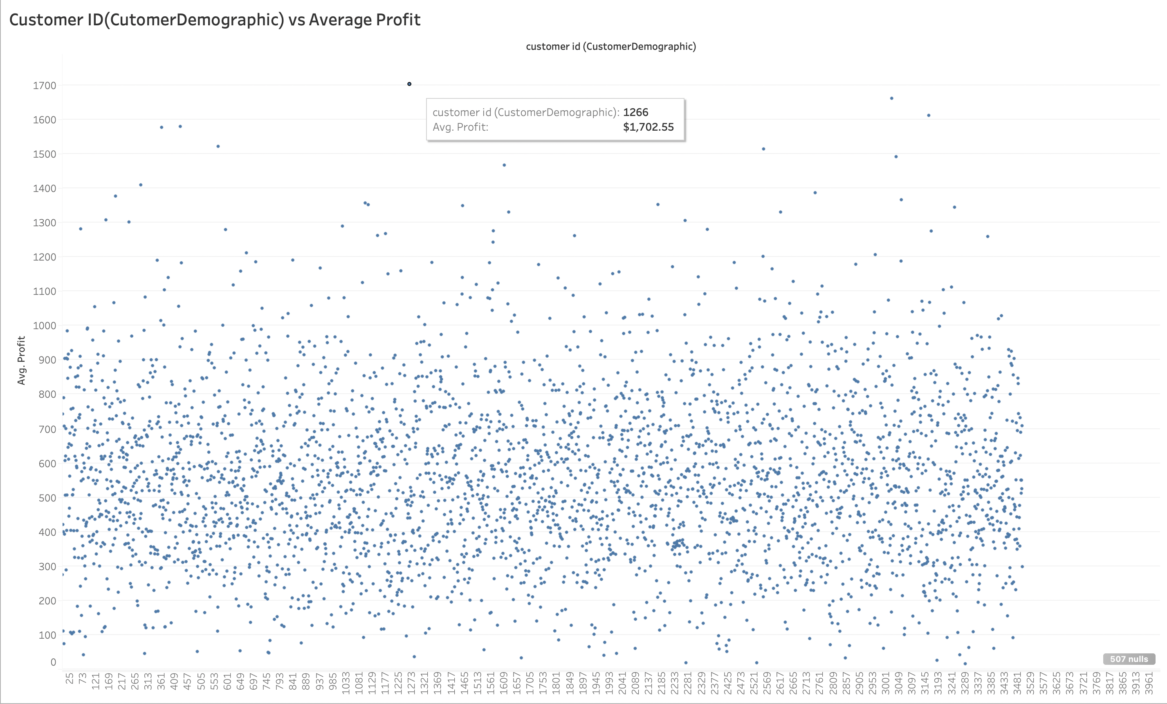
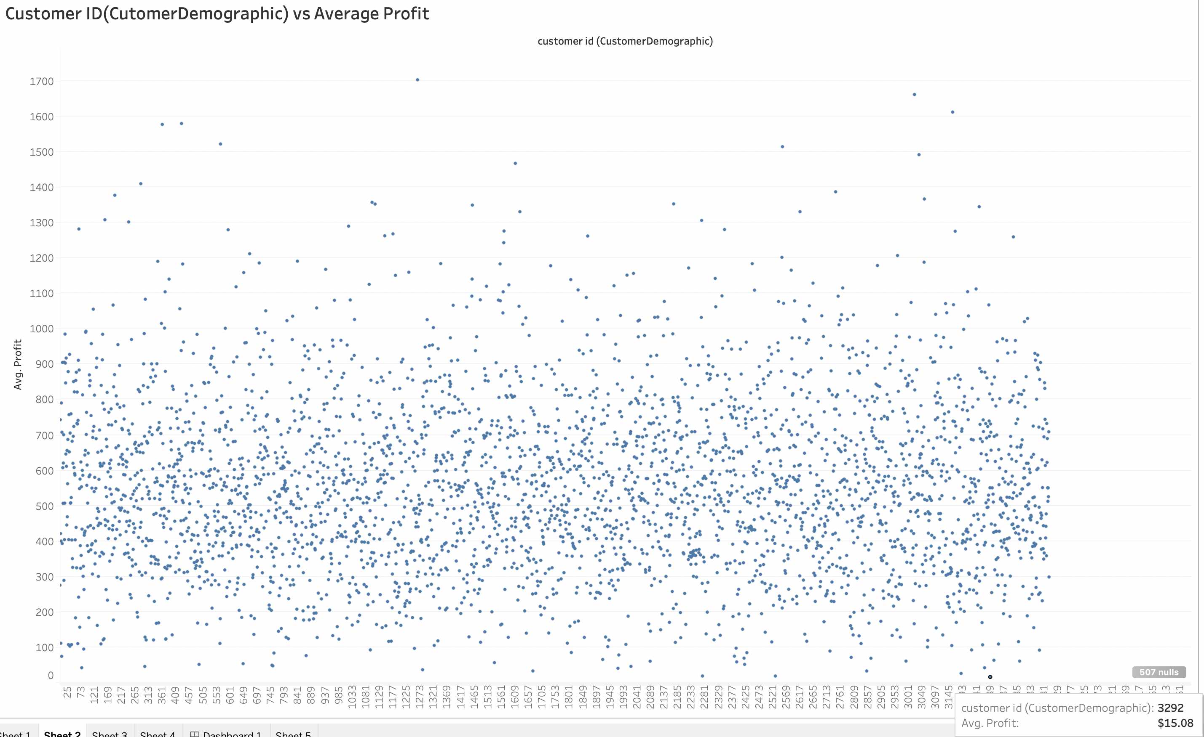
Vishnav Tuli
Vishnav Tuli
During the data analysis, we examined the relationship between Customer ID (CustomerDemographic) and average profit. We discovered that CustomerID 1266, from the customerDemographic sheet, had the highest average profit of $1,702.55. Conversely, CustomerID 3292, also from the customerDemographic sheet, generated the lowest profit of $15.08.
This trend analysis provides valuable insights into which customers are generating the highest average profit. To present this information clearly, I created a bar graph in shapes format. This graph allows for a more precise and visual understanding of the trends in customer profitability. By examining the graph, we can easily identify the variations and patterns in average profit across different customer IDs.

Slide 7
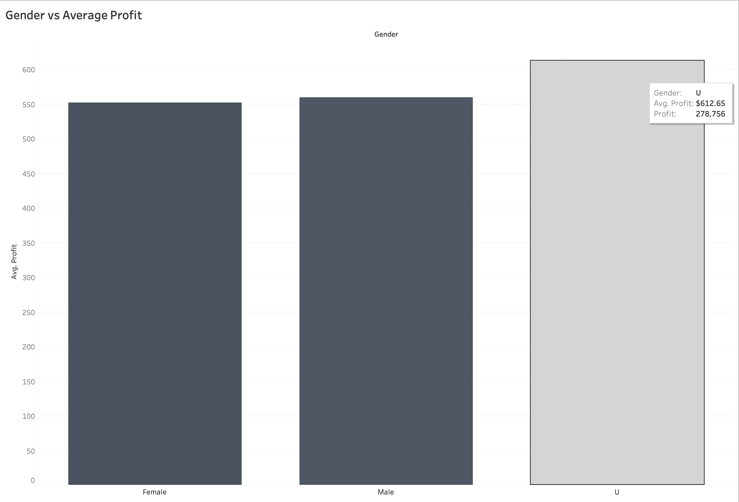
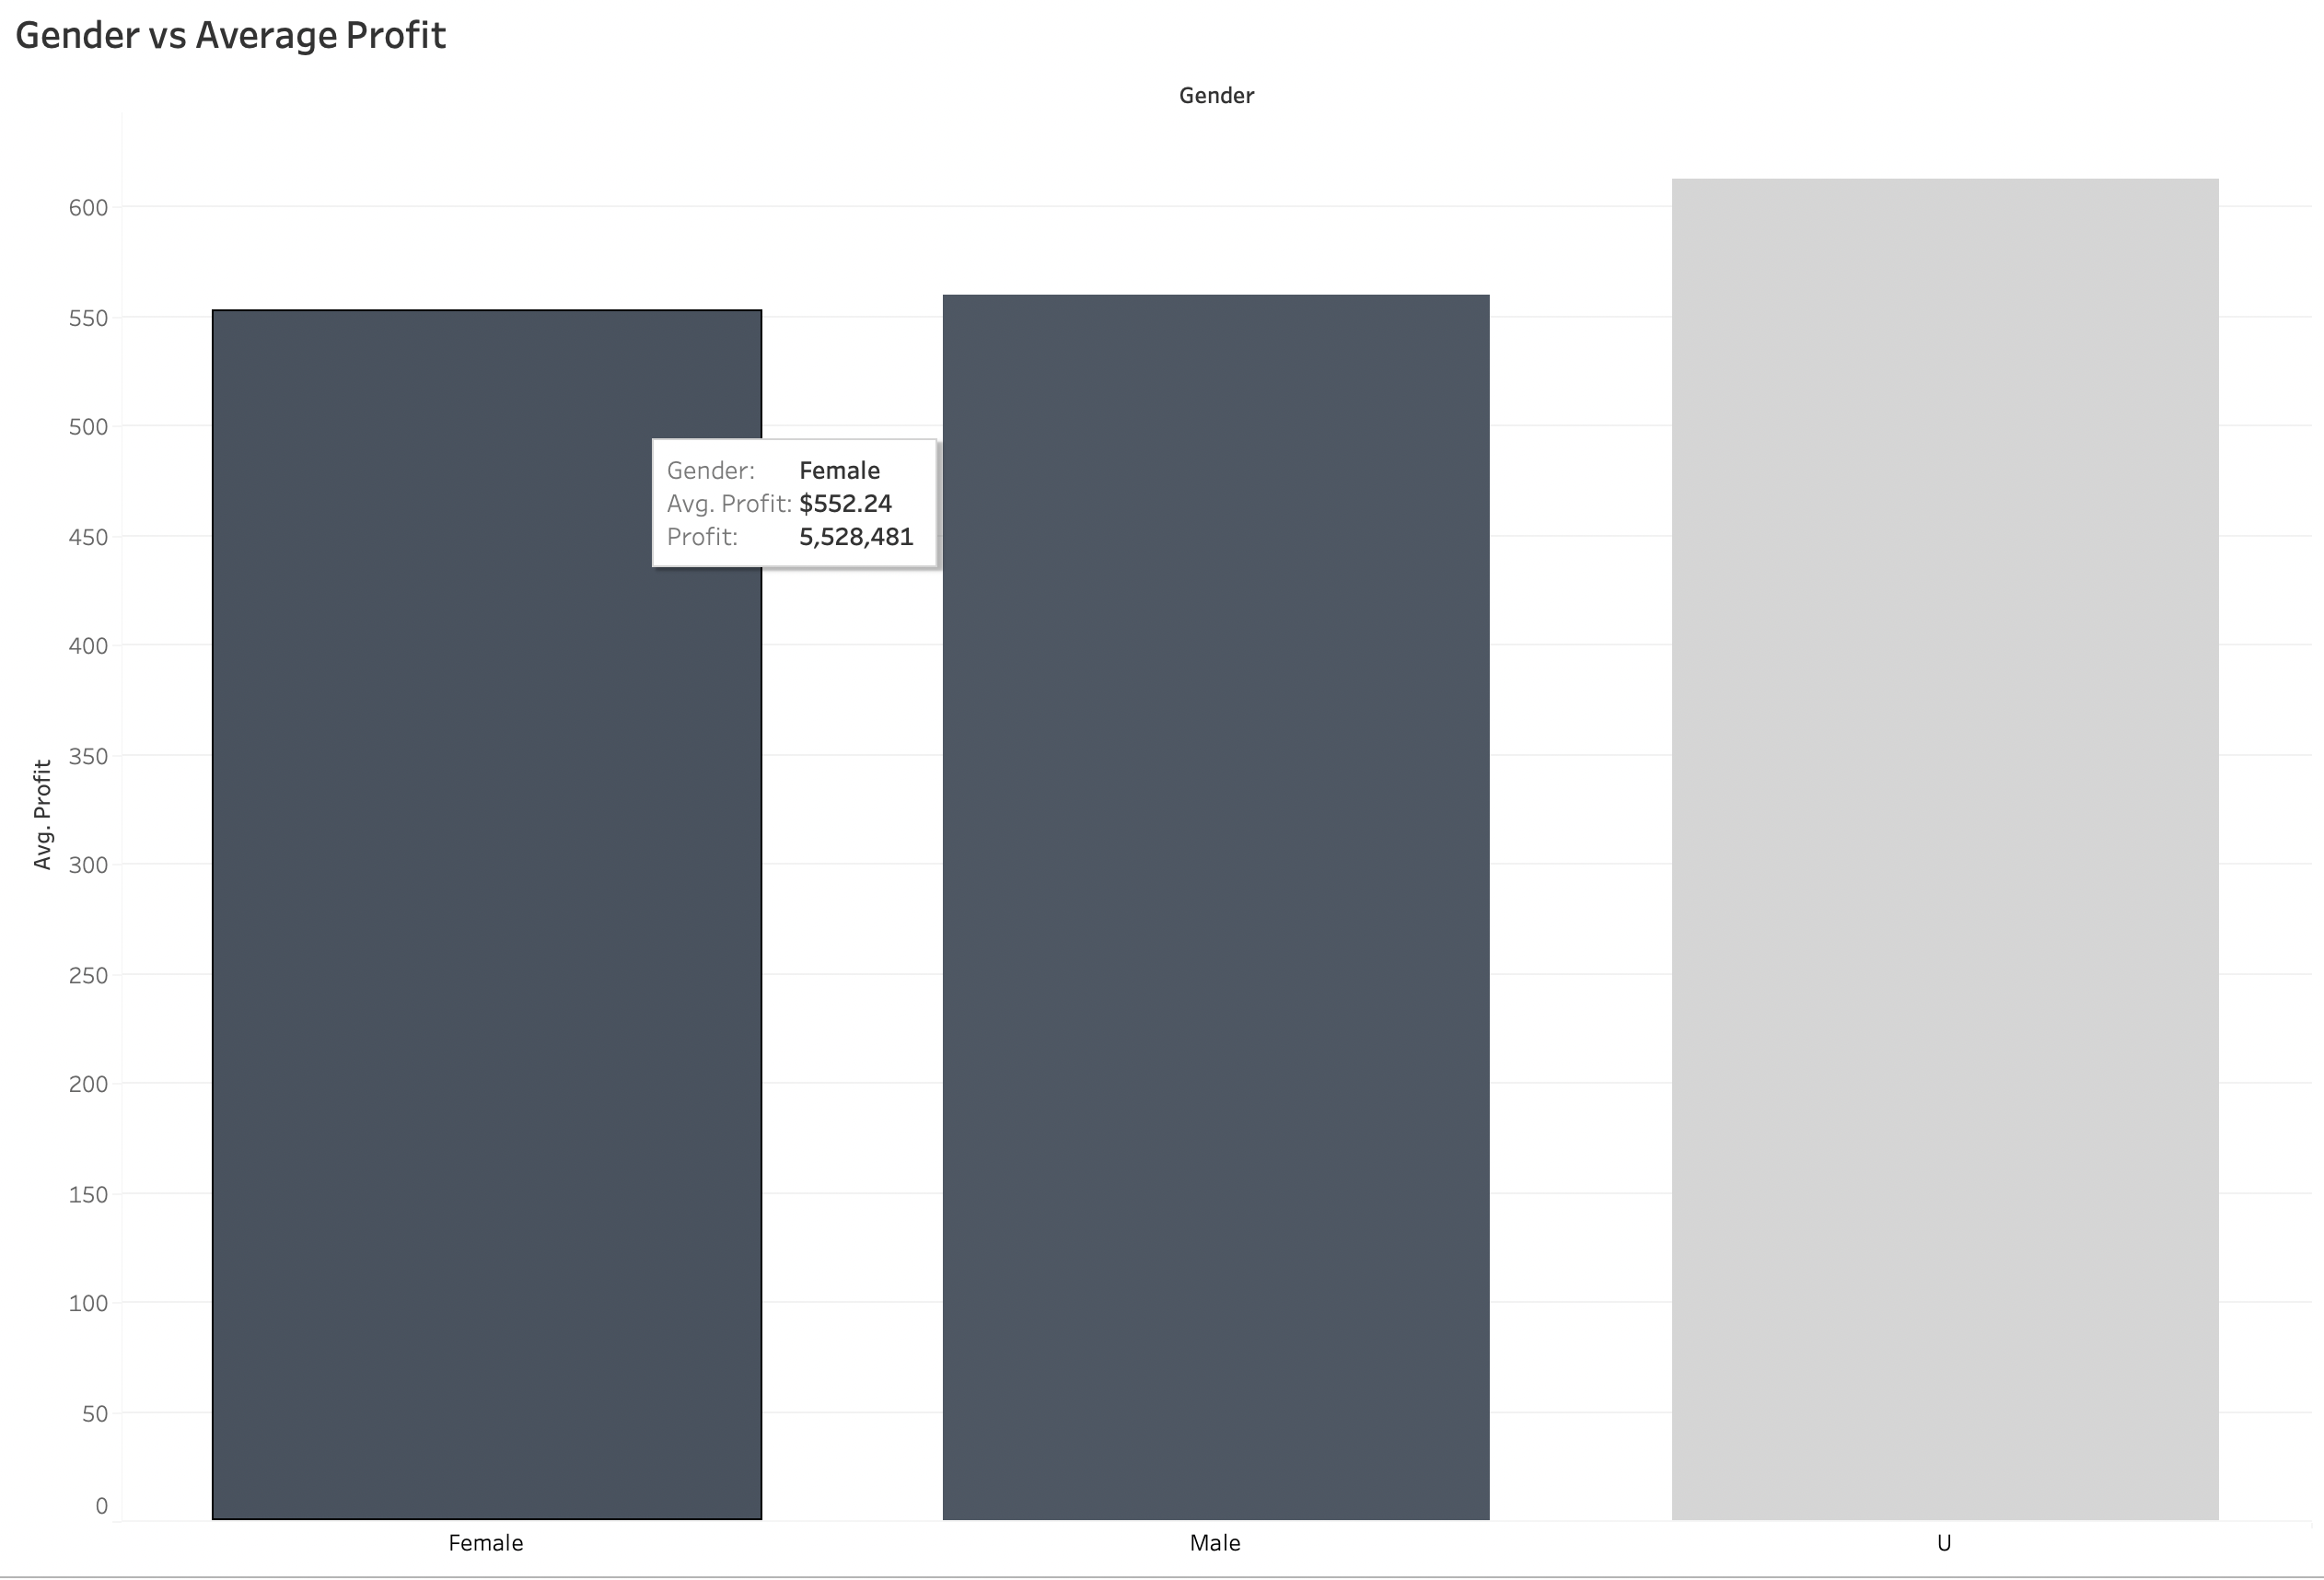
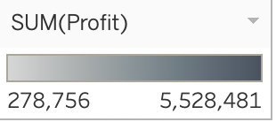
Vishnav Tuli
Vishnav Tuli
During the data analysis, we examined the relationship between gender and average profit. Our findings revealed that Gender U generated the highest average profit of $612.65, while Gender Female generated the lowest profit of $552.24. This analysis enables us to identify which gender is associated with the highest average profit.
To present these insights effectively, I created a bar graph in a shapes format. This graph provides a clear and concise visual representation, allowing for a precise understanding of the trends. By examining the graph, we can easily observe and interpret the variations in average profit between different genders. This graphical representation facilitates a better understanding of the data patterns and highlights the gender associated with the highest average profit.

